Slide 1
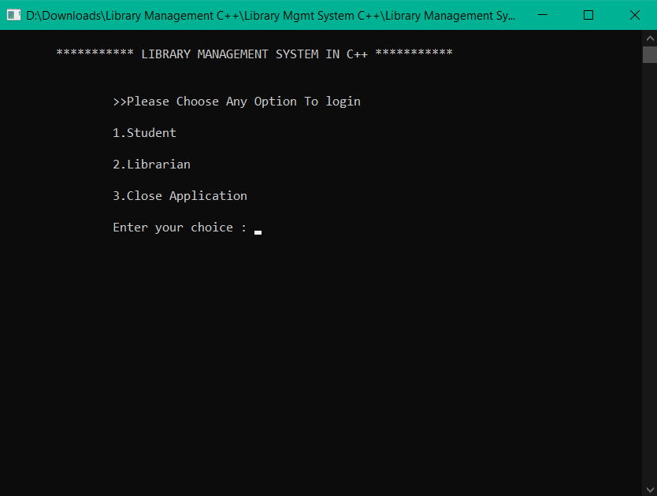
Library Management System
Submitted to:-
Department: Training and placement
Faculty: Ram Babu Lovewanshi
Submitted by:-
Name:-Mayank Raj
Enroll No:-0103EC181084

Slide 2
Declaration
I hereby declare that this project of “Library Management System” has not been copied from anywhere but designed & developed by me through the help of my college faculties for which I am very thankful of them.
Student Name: Mayank Raj
Enrollment No: 0103EC181084

Slide 3
INDEX
Introduction of the project
Objective
Requirement
About Code Blocks
Various forms
Limitation
Future Enhancement
Conclusion

Slide 4
INTRODUCTION OF THE PROJECT
This project “ Library Management System” is developed in C++. The aim of this project is to handle all library workflow like adding new book, issue books to students, modify and delete added books.
This software conatain different login functionality for librarian and student and logging in of librarian is password protected.

Slide 5
OBJECTIVE
Using this software student can check availability of different books branch wise and can issue the required book.
On the other hand librarian can logged In using credentials and can:-
Add books
Keep count of various books
View book
Modify books
Issue a book
Change Password

Slide 6
REQUIREMENT
HARDWARE
Computer/processor : Pentium personal computer with minimum 90 MHz or higher processor.
Memory : 256 MB RAM (128 recommended)
Operating system : windows 10 Operating system.
Peripheral/Miscellaneous: Mouse, keyboard
SOFTWARE REQUIREMENT
Programming : C++
Database : File Handling
IDE : Code Blocks/GCC Compiler

Slide 7
CODEBLOCKS
Code::Blocks is a free, open-source cross-platform IDE that supports multiple compilers including GCC, Clang and Visual C++. It is developed in C++ using wxWidgets as the GUI toolkit. Using a plugin architecture, its capabilities and features are defined by the provided plugins. Currently, Code::Blocks is oriented towards C, C++, and Fortran. It has a custom build system and optional Make support.

Slide 8
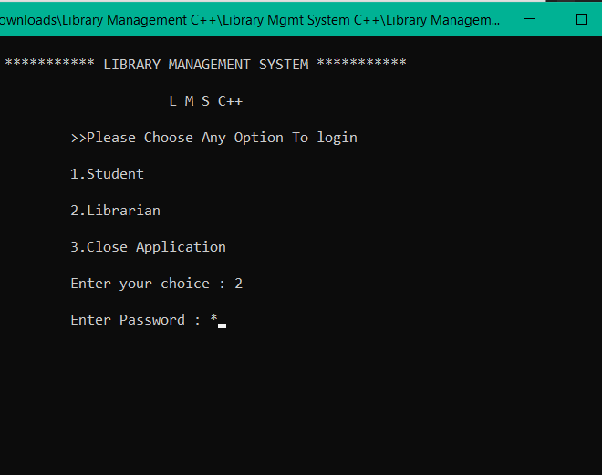
LOGIN PAGE

Slide 9
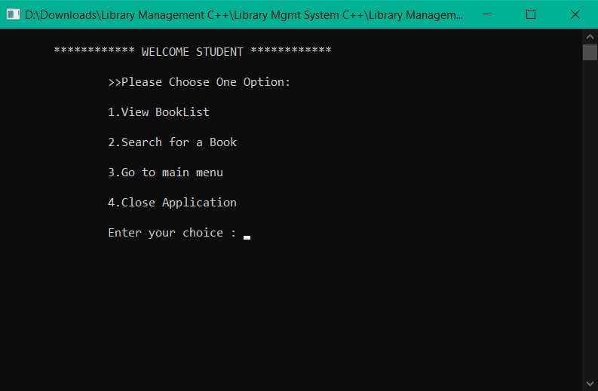
Menu for student

Slide 10
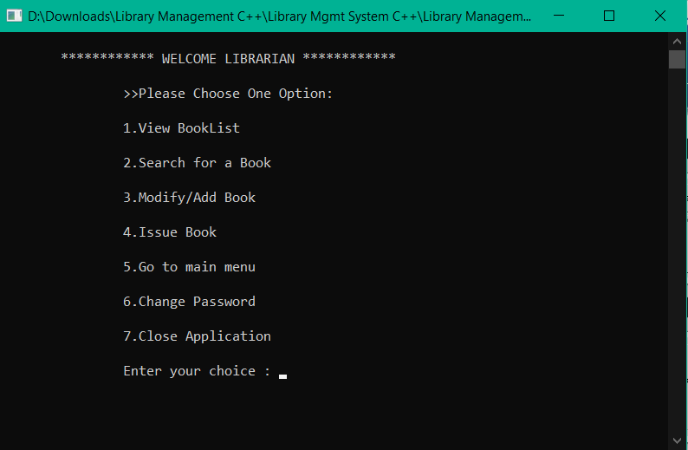
Menu For Librarian

Slide 11
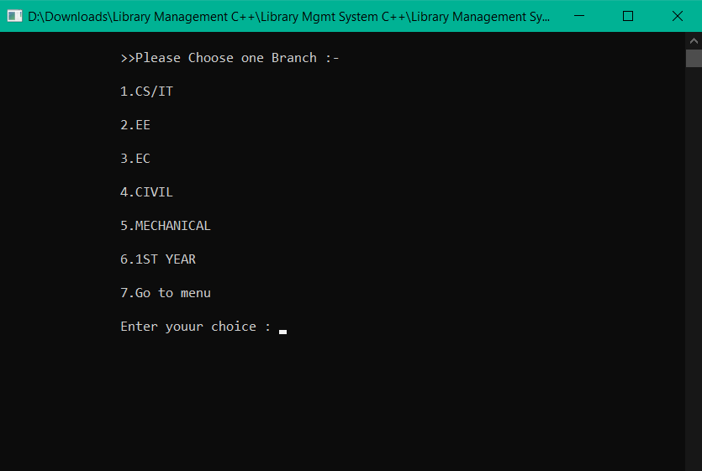
Categorization of Books branch wise

Slide 12
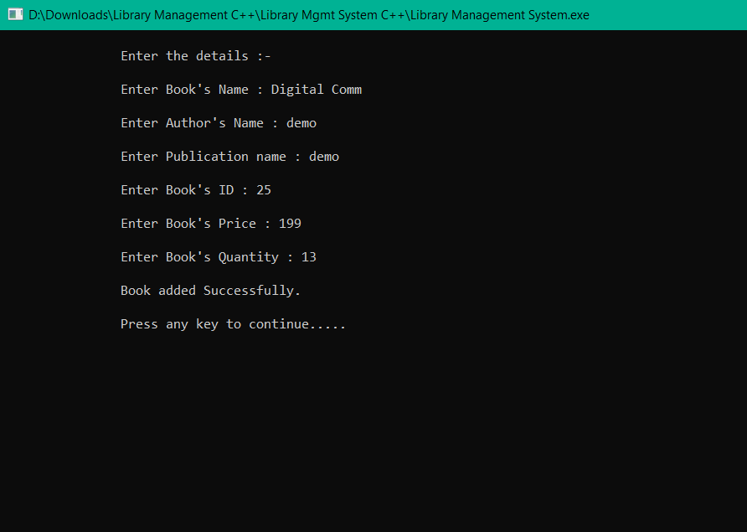
Adding New Book

Slide 13
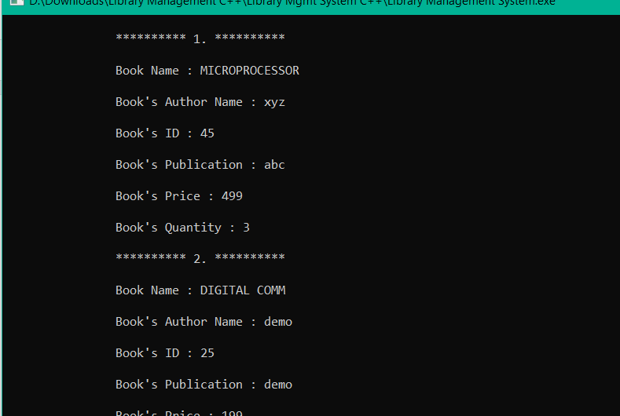
View Books

Slide 14
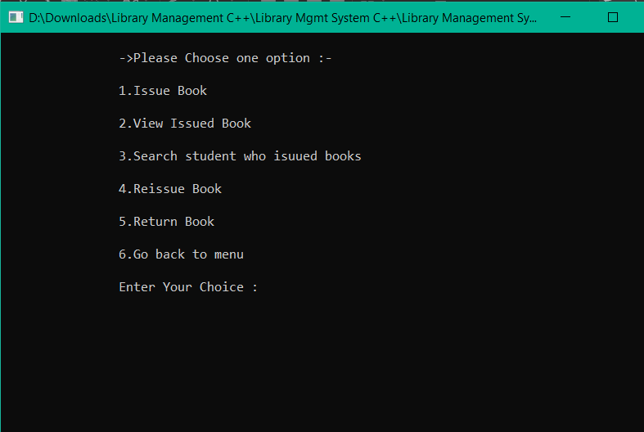
Issuing of books

Slide 15
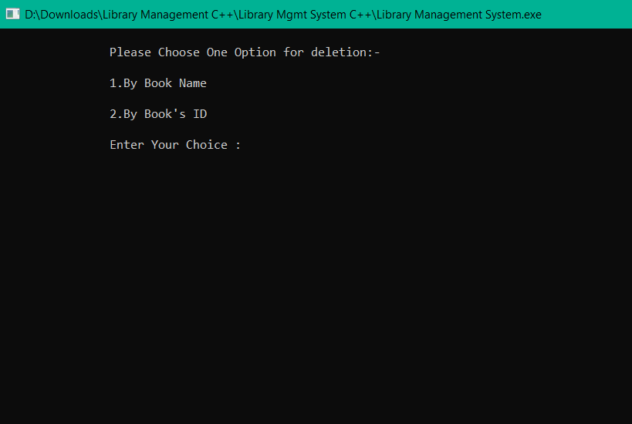
Deletion Of books

Slide 16
LIMITATIONS
Currently all the procedure and database is Implemented in offline mode and not in online mode.
This project is a console based application and do not contain any graphics.

Slide 17
FUTURE ENHANCEMENT
All Procedure along with database can be implemented online this could save time and will became more feasible.
It can be provided online with the help of android application.

Slide 18
Conclusion
With the help of this project Library Management has become fully computerized thus reducing the time consumption and paperwork. Now it has become very easy to Keep track of all the books, add a new book, issue a book etc. Overall, with this project, we can perform all library related activities. Library Management System is C++ console based application without graphics. It is compiled in Code::Blocks with gcc compiler.

Slide 19
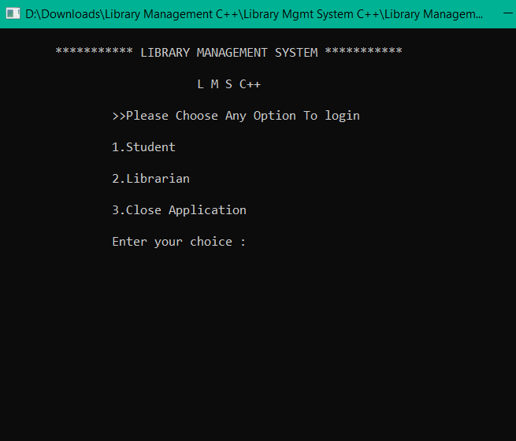
Thank You

